Slide 1


Embedded Systems Design
Chapter 15: Analog to Digital Converters
15.1 Analog to Digital Converters - Overview
Brock J. LaMeres, Ph.D.

Slide 2
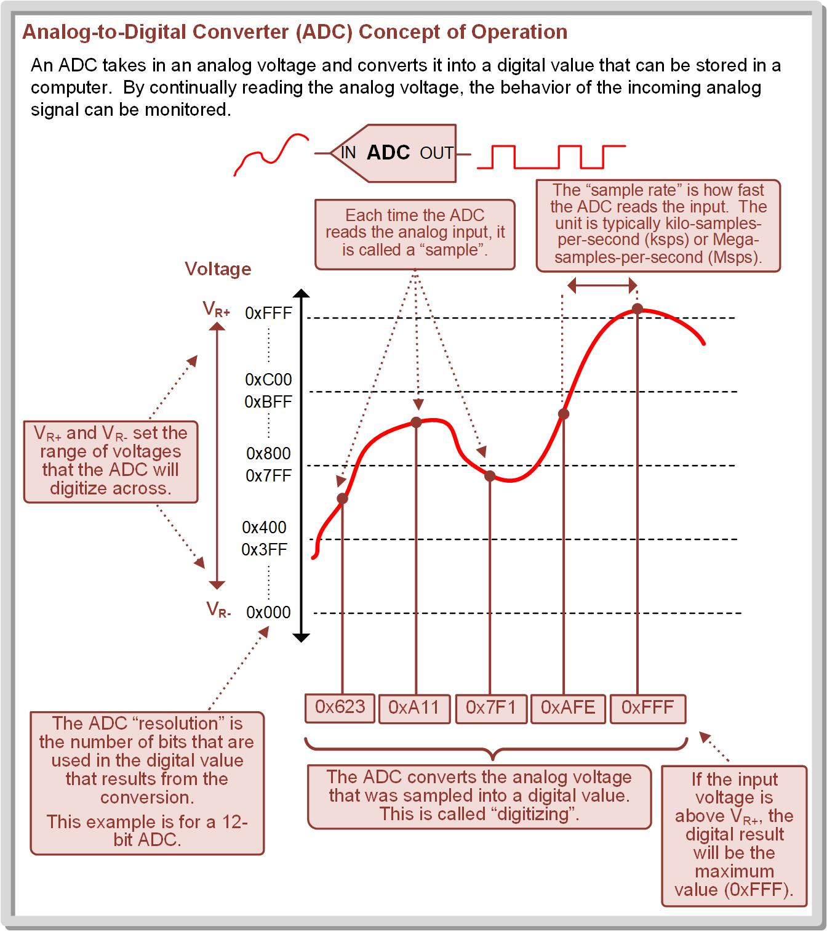
Ch. 15: Analog to Digital Converters
15.1 Analog to Digital Converters
Analog-to-Digital Converter (ADC or A2D) – a circuit that takes in an analog voltage and produces a digital representation of its value.
15.1 Analog to Digital Converters

Slide 3
Ch. 15: Analog to Digital Converters
15.1 Analog to Digital Converters
time
15.1 Analog to Digital Converters

Slide 4
Ch. 15: Analog to Digital Converters
15.1 Analog to Digital Converters
Sample – the action of duplicating the voltage value of the input signal.
Hold – the action of holding the voltage for a brief amount of time by use of a capacitor.
time
15.1 Analog to Digital Converters

Slide 5
Ch. 15: Analog to Digital Converters
15.1 Analog to Digital Converters
The Sample is accomplished by momentarily connecting the signal to a capacitor in order to charge it up to the same voltage.
The Hold is accomplished by disconnecting the signal and allowing the conversion to be conducted on the voltage on the capacitor.
time
15.1 Analog to Digital Converters

Slide 6
Ch. 15: Analog to Digital Converters
15.1 Analog to Digital Converters
The Sample-and-Hold circuitry is designed so that this can be accomplished very quickly so that it can disconnect from the input signal as soon as possible to avoid altering its signal integrity.
time
15.1 Analog to Digital Converters

Slide 7
Ch. 15: Analog to Digital Converters
15.1 Analog to Digital Converters
Input Voltage Range – The voltage is digitized within a range of voltages from:
Voltage Reference High (V_{R+})
Voltage Reference High (V_{R-})
V_{R+}
V_{R-}
time
15.1 Analog to Digital Converters

Slide 8
Ch. 15: Analog to Digital Converters
15.1 Analog to Digital Converters
The goal of the conversion is to convert the analog voltage into a digital number.
This is called digitizing, quantizing, or discretizing.
V_{R+}
V_{R-}
time
15.1 Analog to Digital Converters

Slide 9
Ch. 15: Analog to Digital Converters
15.1 Analog to Digital Converters
n represents the number of bits in the digital value of the conversion.
V_{R+}
1
0
n=1
V_{R-}
time
Sample=0
15.1 Analog to Digital Converters

Slide 10
Ch. 15: Analog to Digital Converters
15.1 Analog to Digital Converters
n represents the number of bits in the digital value of the conversion.
The input voltage range is divided into 2^{n} discrete zones.
V_{R+}
1
0
n=1
V_{R-}
time
Sample=0
15.1 Analog to Digital Converters

Slide 11
Ch. 15: Analog to Digital Converters
15.1 Analog to Digital Converters
The larger the n, the closer the digital value is to the actual analog voltage.
V_{R+}
1
0
n=1
V_{R-}
time
Sample=0
15.1 Analog to Digital Converters

Slide 12
Ch. 15: Analog to Digital Converters
15.1 Analog to Digital Converters
The larger the n, the closer the digital value is to the actual analog voltage.
V_{R+}
11
10
01
00
n=2
V_{R-}
time
Sample=01
15.1 Analog to Digital Converters

Slide 13
Ch. 15: Analog to Digital Converters
15.1 Analog to Digital Converters
The larger the n, the closer the digital value is to the actual analog voltage.
V_{R+}
111
110
101
100
011
010
001
000
n=3
V_{R-}
time
Sample=010
15.1 Analog to Digital Converters

Slide 14
Ch. 15: Analog to Digital Converters
15.1 Analog to Digital Converters
The larger the n, the closer the digital value is to the actual analog voltage.
V_{R+}
1111
1110
1101
1100
1011
1010
1001
1000
0111
0110
0101
0100
0011
0010
0001
0000
V_{R-}
time
n=4
Sample=0100
15.1 Analog to Digital Converters

Slide 15
Ch. 15: Analog to Digital Converters
15.1 Analog to Digital Converters
The number of bits n is called the ADC’s resolution.
V_{R+}
1111
1110
1101
1100
1011
1010
1001
1000
0111
0110
0101
0100
0011
0010
0001
0000
V_{R-}
time
n=4
Sample=0100
15.1 Analog to Digital Converters

Slide 16
Ch. 15: Analog to Digital Converters
15.1 Analog to Digital Converters
The number of bits n is called the ADC’s resolution.
MCU’s typically have ADC’s with resolutions of 8 to 16 bits.
V_{R+}
1111
1110
1101
1100
1011
1010
1001
1000
0111
0110
0101
0100
0011
0010
0001
0000
V_{R-}
time
n=4
Sample=0100
15.1 Analog to Digital Converters

Slide 17
Ch. 15: Analog to Digital Converters
15.1 Analog to Digital Converters
The number of bits n is called the ADC’s resolution.
MCU’s typically have ADC’s with resolutions of 8 to 16 bits.
The MSP430 has up to 12-bits of resolution.
V_{R+}
1111
1110
1101
1100
1011
1010
1001
1000
0111
0110
0101
0100
0011
0010
0001
0000
V_{R-}
time
n=4
Sample=0100
15.1 Analog to Digital Converters

Slide 18
Ch. 15: Analog to Digital Converters
15.1 Analog to Digital Converters
The precision of an ADC is the smallest voltage that the LSB of the digital output can represent.
V_{R+}
1111
1110
1101
1100
1011
1010
1001
1000
0111
0110
0101
0100
0011
0010
0001
0000
V_{R-}
time
n=4
Sample=0100
15.1 Analog to Digital Converters

Slide 19
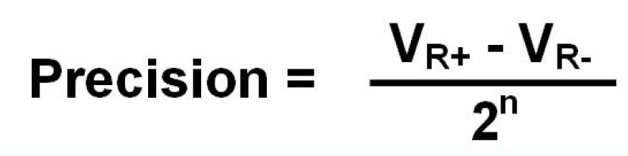
Ch. 15: Analog to Digital Converters
15.1 Analog to Digital Converters
The precision of an ADC is the smallest voltage that the LSB of the digital output can represent.
This is found by dividing the input voltage range by the number of discrete zones.
V_{R+}
1111
1110
1101
1100
1011
1010
1001
1000
0111
0110
0101
0100
0011
0010
0001
0000
V_{R-}
time
n=4
Sample=0100
15.1 Analog to Digital Converters

Slide 20
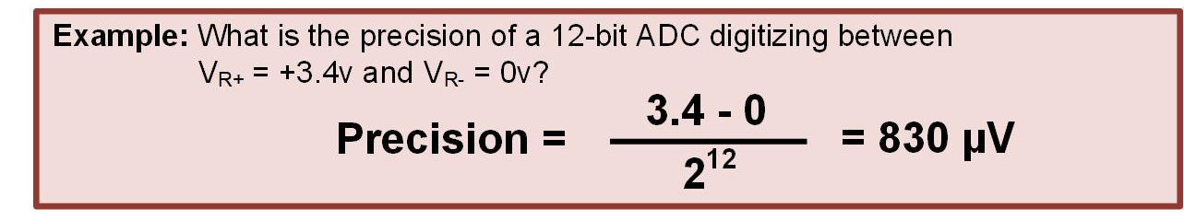
Ch. 15: Analog to Digital Converters
15.1 Analog to Digital Converters
V_{R+}
V_{R-}
time
15.1 Analog to Digital Converters

Slide 21

Ch. 15: Analog to Digital Converters
15.1 Analog to Digital Converters
The original analog value is found by multiplying the digital conversion result (N_{ADC}) with the resolution.
V_{R+}
1111
1110
1101
1100
1011
1010
1001
1000
0111
0110
0101
0100
0011
0010
0001
0000
V_{R-}
time
n=4
Sample=0100
15.1 Analog to Digital Converters

Slide 22
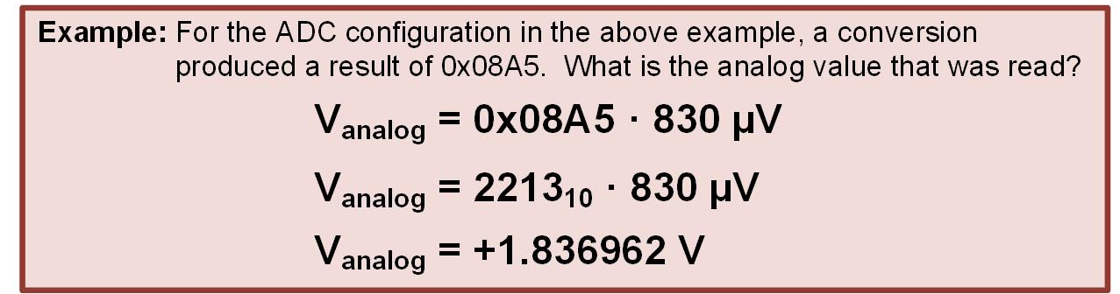
Ch. 15: Analog to Digital Converters
15.1 Analog to Digital Converters
V_{R+}
1111
1110
1101
1100
1011
1010
1001
1000
0111
0110
0101
0100
0011
0010
0001
0000
V_{R-}
time
15.1 Analog to Digital Converters

Slide 23
Ch. 15: Analog to Digital Converters
15.1 Analog to Digital Converters
The accuracy is how close the digital output is to the input signal.
V_{R+}
1111
1110
1101
1100
1011
1010
1001
1000
0111
0110
0101
0100
0011
0010
0001
0000
V_{R-}
time
n=4
Sample=0100
15.1 Analog to Digital Converters

Slide 24

Ch. 15: Analog to Digital Converters
15.1 Analog to Digital Converters
The accuracy is how close the digital output is to the input signal.
By design, an ADC will only ever be able to get within +/- ½ LSB of the original analog value.
V_{R+}
1111
1110
1101
1100
1011
1010
1001
1000
0111
0110
0101
0100
0011
0010
0001
0000
V_{R-}
time
n=4
Sample=0100
15.1 Analog to Digital Converters

Slide 25
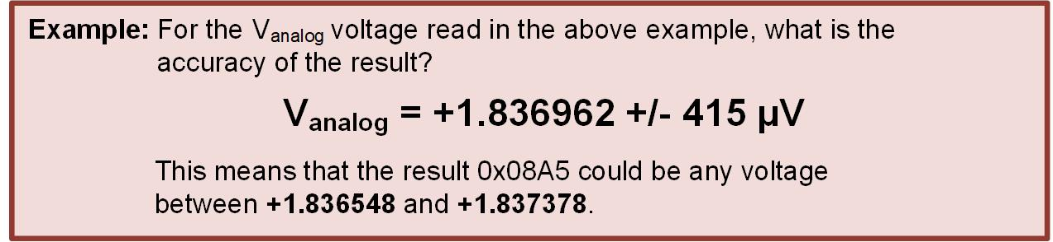
Ch. 15: Analog to Digital Converters
15.1 Analog to Digital Converters
V_{R+}
1111
1110
1101
1100
1011
1010
1001
1000
0111
0110
0101
0100
0011
0010
0001
0000
V_{R-}
time
15.1 Analog to Digital Converters

Slide 26
Ch. 15: Analog to Digital Converters
15.1 Analog to Digital Converters
The voltage can be sampled over time to create a list of digital values.
V_{R+}
1111
1110
1101
1100
1011
1010
1001
1000
0111
0110
0101
0100
0011
0010
0001
0000
V_{R-}
time
n=4
0100
15.1 Analog to Digital Converters

Slide 27
Ch. 15: Analog to Digital Converters
15.1 Analog to Digital Converters
The voltage can be sampled over time to create a list of digital values.
V_{R+}
1111
1110
1101
1100
1011
1010
1001
1000
0111
0110
0101
0100
0011
0010
0001
0000
V_{R-}
time
n=4
0100
1000
15.1 Analog to Digital Converters

Slide 28
Ch. 15: Analog to Digital Converters
15.1 Analog to Digital Converters
The voltage can be sampled over time to create a list of digital values.
V_{R+}
1111
1110
1101
1100
1011
1010
1001
1000
0111
0110
0101
0100
0011
0010
0001
0000
V_{R-}
time
n=4
0100
0111
1000
15.1 Analog to Digital Converters

Slide 29
Ch. 15: Analog to Digital Converters
15.1 Analog to Digital Converters
The voltage can be sampled over time to create a list of digital values.
V_{R+}
1111
1110
1101
1100
1011
1010
1001
1000
0111
0110
0101
0100
0011
0010
0001
0000
V_{R-}
time
n=4
0100
0111
1000
0101
15.1 Analog to Digital Converters

Slide 30
Ch. 15: Analog to Digital Converters
15.1 Analog to Digital Converters
The voltage can be sampled over time to create a list of digital values.
V_{R+}
1111
1110
1101
1100
1011
1010
1001
1000
0111
0110
0101
0100
0011
0010
0001
0000
V_{R-}
time
n=4
0100
0111
1001
1000
0101
15.1 Analog to Digital Converters

Slide 31
Ch. 15: Analog to Digital Converters
15.1 Analog to Digital Converters
The voltage can be sampled over time to create a list of digital values.
V_{R+}
1111
1110
1101
1100
1011
1010
1001
1000
0111
0110
0101
0100
0011
0010
0001
0000
V_{R-}
time
n=4
0100
0111
1001
1000
0101
1101
15.1 Analog to Digital Converters

Slide 32
Ch. 15: Analog to Digital Converters
15.1 Analog to Digital Converters
The voltage can be sampled over time to create a list of digital values.
V_{R+}
1111
1110
1101
1100
1011
1010
1001
1000
0111
0110
0101
0100
0011
0010
0001
0000
V_{R-}
time
n=4
0100
0111
1001
1110
1000
0101
1101
15.1 Analog to Digital Converters

Slide 33
Ch. 15: Analog to Digital Converters
15.1 Analog to Digital Converters
The voltage can be sampled over time to create a list of digital values.
V_{R+}
1111
1110
1101
1100
1011
1010
1001
1000
0111
0110
0101
0100
0011
0010
0001
0000
V_{R-}
time
n=4
0100
0111
1001
1110
1000
0101
1101
1101
15.1 Analog to Digital Converters

Slide 34
Ch. 15: Analog to Digital Converters
15.1 Analog to Digital Converters
The sample period (T_{SA}) is the time between samples.
V_{R+}
1111
1110
1101
1100
1011
1010
1001
1000
0111
0110
0101
0100
0011
0010
0001
0000
V_{R-}
time
n=4
0100
0111
1001
1110
1000
0101
1101
1101
T_{SA}
15.1 Analog to Digital Converters

Slide 35
Ch. 15: Analog to Digital Converters
15.1 Analog to Digital Converters
The sampling rate is the frequency of sampling: f_{SA}= 1/T_{SA}
V_{R+}
1111
1110
1101
1100
1011
1010
1001
1000
0111
0110
0101
0100
0011
0010
0001
0000
V_{R-}
time
n=4
0100
0111
1001
1110
1000
0101
1101
1101
T_{SA}
15.1 Analog to Digital Converters

Slide 36
Ch. 15: Analog to Digital Converters
15.1 Analog to Digital Converters
The sampling rate is the frequency of sampling: f_{SA}= 1/T_{SA}
This has units of samples-per-second (i.e., ksps, Msps).
V_{R+}
1111
1110
1101
1100
1011
1010
1001
1000
0111
0110
0101
0100
0011
0010
0001
0000
V_{R-}
time
n=4
0100
0111
1001
1110
1000
0101
1101
1101
T_{SA}
15.1 Analog to Digital Converters

Slide 37
Ch. 15: Analog to Digital Converters
15.1 Analog to Digital Converters
If you sample fast enough, you can reconstruct the original signal.
V_{R+}
1111
1110
1101
1100
1011
1010
1001
1000
0111
0110
0101
0100
0011
0010
0001
0000
V_{R-}
time
n=4
0100
0111
1001
1110
1000
0101
1101
1101
15.1 Analog to Digital Converters

Slide 38
Ch. 15: Analog to Digital Converters
15.1 Analog to Digital Converters
If you sample fast enough, you can reconstruct the original signal.
Nyquist-Shannon Sampling Theorem states you need to sample at least twice as fast as the frequency of the incoming signal to accurately reconstruct the original waveform.
V_{R+}
1111
1110
1101
1100
1011
1010
1001
1000
0111
0110
0101
0100
0011
0010
0001
0000
V_{R-}
time
n=4
0100
0111
1001
1110
1000
0101
1101
1101
15.1 Analog to Digital Converters

Slide 39
Ch. 15: Analog to Digital Converters
15.1 Analog to Digital Converters
The MSP430FR2355 can sample up to 200 ksps.
V_{R+}
1111
1110
1101
1100
1011
1010
1001
1000
0111
0110
0101
0100
0011
0010
0001
0000
V_{R-}
time
n=4
0100
0111
1001
1110
1000
0101
1101
1101
15.1 Analog to Digital Converters

Slide 40
Ch. 15: Analog to Digital Converters
15.1 Analog to Digital Converters
12-bit Example
15.1 Analog to Digital Converters

Slide 41

Embedded Systems Design
Chapter 15: Analog to Digital Converters
15.1 Analog to Digital Converters - Overview
www.youtube.com/c/DigitalLogicProgramming_LaMeres
Brock J. LaMeres, Ph.D.

Slide 42
Embedded Systems Design
Chapter 15: Analog to Digital Converters
15.2 ADC Operation on the MSP430FR2355 - Configuration
Brock J. LaMeres, Ph.D.

Slide 43
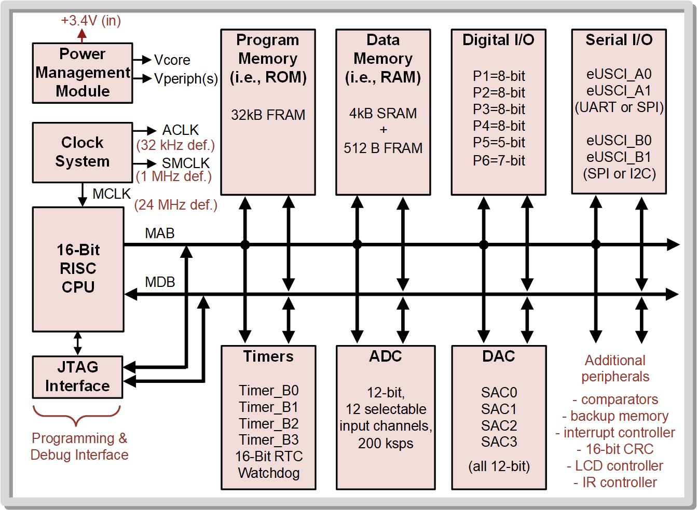
Ch. 15: Analog to Digital Converters
15.2 ADC Operation on the MSP430FR2355
15.2 ADC Operation on the MSP430FR2355

Slide 44
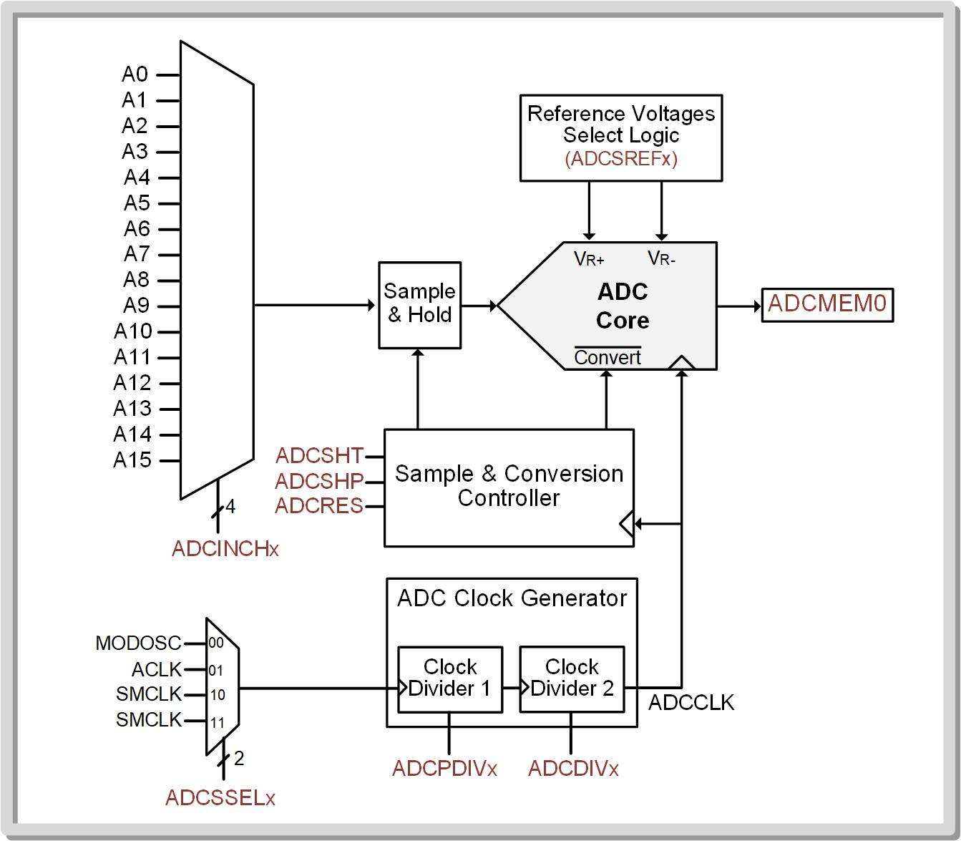
Ch. 15: Analog to Digital Converters
15.2 ADC Operation on the MSP430FR2355
15.2 ADC Operation on the MSP430FR2355

Slide 45
Ch. 15: Analog to Digital Converters
15.2 ADC Operation on the MSP430FR2355
The MSP430 contains an ADC core with selectable resolution (8-bit, 10-bit, 12-bit).
15.2 ADC Operation on the MSP430FR2355

Slide 46
Ch. 15: Analog to Digital Converters
15.2 ADC Operation on the MSP430FR2355
The ADC can be driven with 1 of 16 inputs that are selected using an analog multiplexer that sits in front of the ADC core.
15.2 ADC Operation on the MSP430FR2355

Slide 47
Ch. 15: Analog to Digital Converters
15.2 ADC Operation on the MSP430FR2355
The ADC can be driven with 1 of 16 inputs that are selected using an analog multiplexer that sits in front of the ADC core.
A0 → A11 are connected to pins that share with ports (use Port Function Select Registers = 11).
15.2 ADC Operation on the MSP430FR2355

Slide 48
Ch. 15: Analog to Digital Converters
15.2 ADC Operation on the MSP430FR2355
The ADC can be driven with 1 of 16 inputs that are selected using an analog multiplexer that sits in front of the ADC core.
A0 → A11 are connected to pins that share with ports (use Port Function Select Registers = 11).
A12 is an on-chip temperature sensor
15.2 ADC Operation on the MSP430FR2355

Slide 49
Ch. 15: Analog to Digital Converters
15.2 ADC Operation on the MSP430FR2355
The ADC can be driven with 1 of 16 inputs that are selected using an analog multiplexer that sits in front of the ADC core.
A0 → A11 are connected to pins that share with ports (use Port Function Select Registers = 11).
A12 is an on-chip temperature sensor
A13 is the internal voltage reference.
15.2 ADC Operation on the MSP430FR2355

Slide 50
Ch. 15: Analog to Digital Converters
15.2 ADC Operation on the MSP430FR2355
The ADC can be driven with 1 of 16 inputs that are selected using an analog multiplexer that sits in front of the ADC core.
A0 → A11 are connected to pins that share with ports (use Port Function Select Registers = 11).
A12 is an on-chip temperature sensor
A13 is the internal voltage reference.
A14 and A15 are VSS and VCC.
15.2 ADC Operation on the MSP430FR2355

Slide 51
Ch. 15: Analog to Digital Converters
15.2 ADC Operation on the MSP430FR2355
The ADC clock source is selectable with two stages of programmable dividers/prescalers.
15.2 ADC Operation on the MSP430FR2355

Slide 52
Ch. 15: Analog to Digital Converters
15.2 ADC Operation on the MSP430FR2355
The ADC clock source is selectable with two stages of programmable dividers/prescalers.
Note: The ADCCL frequency is NOT the sample rate. The sample/convert takes multiple clock settings.
15.2 ADC Operation on the MSP430FR2355

Slide 53
Ch. 15: Analog to Digital Converters
15.2 ADC Operation on the MSP430FR2355
The voltage range of the ADC is also programmable with options of using the power supply (VCC) and GND (VSS), input pins, or a variety of internally generated voltages.
15.2 ADC Operation on the MSP430FR2355

Slide 54
Ch. 15: Analog to Digital Converters
15.2 ADC Operation on the MSP430FR2355
The ADC peripheral also has a large number of programmable options that dictate its behavior in addition to 6 interrupts that can be triggered upon certain conditions.
15.2 ADC Operation on the MSP430FR2355

Slide 55
Ch. 15: Analog to Digital Converters
15.2 ADC Operation on the MSP430FR2355
The basic use model for the ADC peripheral is:
Configure peripheral using a set of registers.
The conversation is started by the user (or by the successful completion of a prior conversation).
The result of the conversation is ready from the ADC’s conversion memory register.
15.2 ADC Operation on the MSP430FR2355

Slide 56
Ch. 15: Analog to Digital Converters
15.2 ADC Operation on the MSP430FR2355
Flags can be used to track the status of the conversion and trigger interrupts to react to various states of the conversion.
15.2 ADC Operation on the MSP430FR2355

Slide 57

Ch. 15: Analog to Digital Converters
15.2 ADC Operation on the MSP430FR2355
ADC Control 0 (ADCCTL0) Register
ADC Control 1 (ADCCTL1) Register
ADC Control 2 (ADCCTL2) Register
ADC Memory Control (ADCMCTL0) Register
ADC Conversion Memory (ADCMEM0) Register
ADC Interrupt Enable (ADCIE) Register
ADC Interrupt Flag (ADCIFG) Register
ADC Interrupt Vector (ADCIV) Register
ADC Window Comparator Low Threshold (ADCLO) Register
ADC Window Comparator High Threshold (ADCHI) Register
Image Courtesy of https://neodem.wp.horizon.ac.uk/
15.2 ADC Operation on the MSP430FR2355

Slide 58
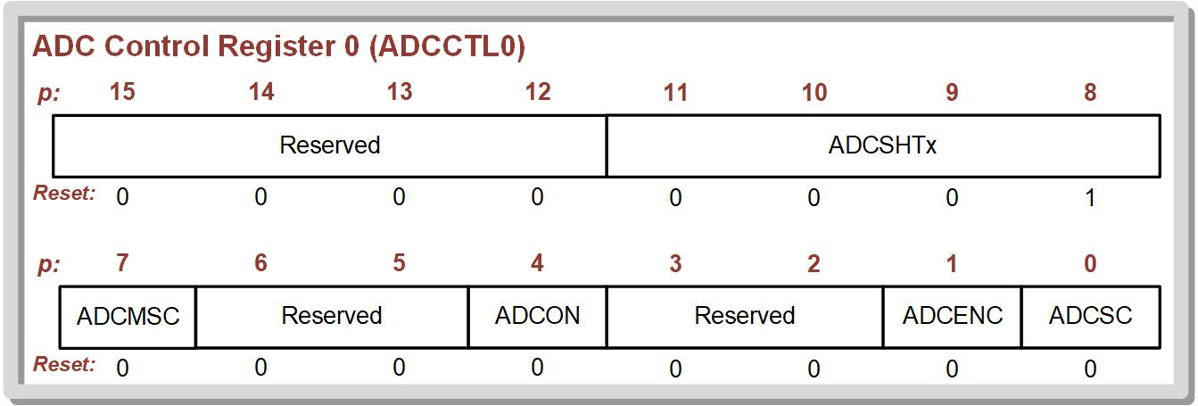
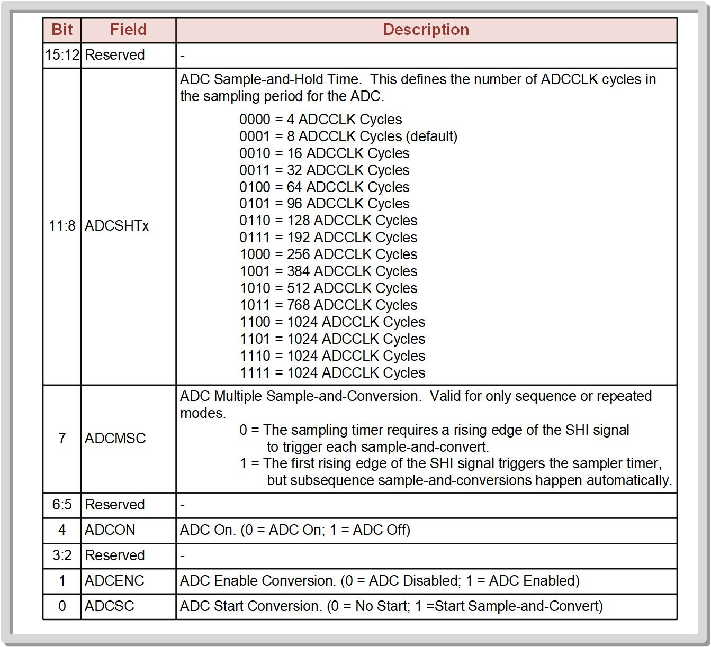
Ch. 15: Analog to Digital Converters
15.2 ADC Operation on the MSP430FR2355
ADCCTL0 contains:
settings for the number of ADCCLK cycles to use during the conversion (ADCSHTx)
how the ADC is triggered (ADCMSC)
turning the ADC on (ADCON)
enabling the conversion (ADCENC)
Starting a conversion (ADCSC).
15.2 ADC Operation on the MSP430FR2355

Slide 59
Ch. 15: Analog to Digital Converters
15.2 ADC Operation on the MSP430FR2355
ADCCTL0 contains:
settings for the number of ADCCLK cycles to use during the conversion (ADCSHTx)
how the ADC is triggered (ADCMSC)
turning the ADC on (ADCON)
enabling the conversion (ADCENC)
Starting a conversion (ADCSC).
The ADCENC and ADCSC bits are used to start a conversion by asserting them simultaneously.
The ADCENC and ADCSC bits are used to start a conversion by asserting them simultaneously.
15.2 ADC Operation on the MSP430FR2355

Slide 60
Ch. 15: Analog to Digital Converters
15.2 ADC Operation on the MSP430FR2355
ADCCTL0
We will use the following for the basic ADC setup
15.2 ADC Operation on the MSP430FR2355

Slide 61
Ch. 15: Analog to Digital Converters
15.2 ADC Operation on the MSP430FR2355
ADCCTL0
We will use the following for the basic ADC setup
We’ll assert these to start a conversion.
15.2 ADC Operation on the MSP430FR2355

Slide 62
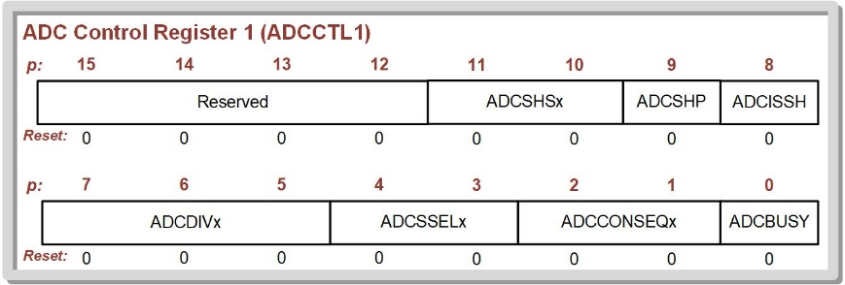
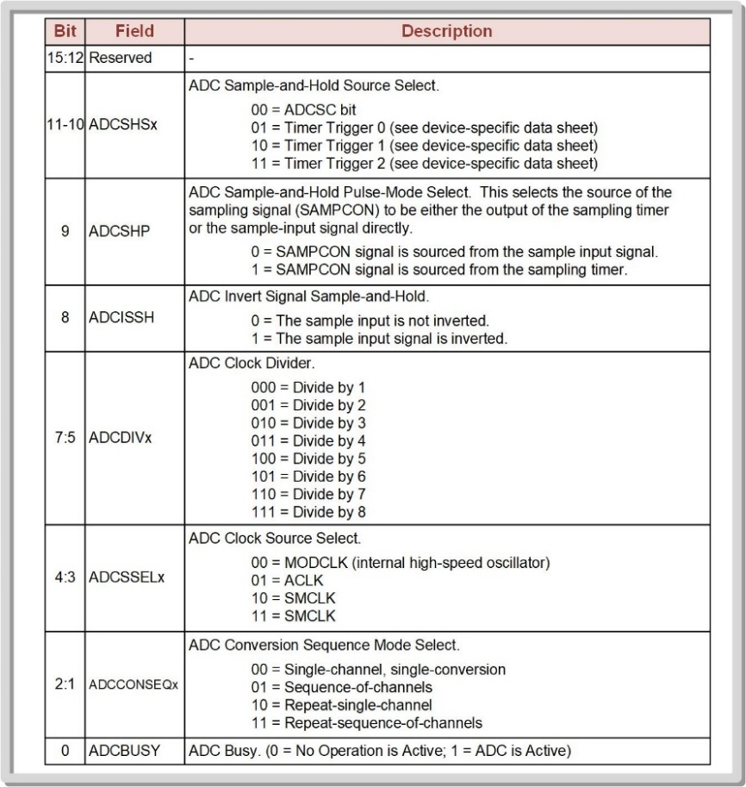
Ch. 15: Analog to Digital Converters
15.2 ADC Operation on the MSP430FR2355
ADCCTL1 contains:
settings for the source of the sample trigger (ADCSHSx)
an option for running the sampler in pulse mode (ADCSHP)
an input inversion option (ADCISSH)
settings for the second clock divider stage (ADCDIVx)
15.2 ADC Operation on the MSP430FR2355

Slide 63
Ch. 15: Analog to Digital Converters
15.2 ADC Operation on the MSP430FR2355
ADCCTL1 contains:
the ADC clock source (ADCSSELx)
whether the conversion is to run once or multiple times upon a trigger (ADCCONSEQx)
a status flag indicating the conversion is busy (ADCBSUSY).
15.2 ADC Operation on the MSP430FR2355

Slide 64
Ch. 15: Analog to Digital Converters
15.2 ADC Operation on the MSP430FR2355
ADCCTL1
We will use the following for the basic ADC setup
15.2 ADC Operation on the MSP430FR2355

Slide 65
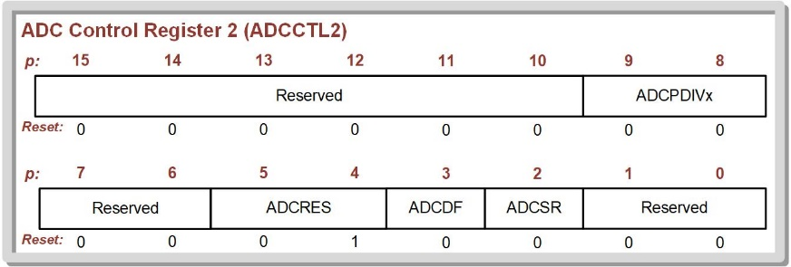
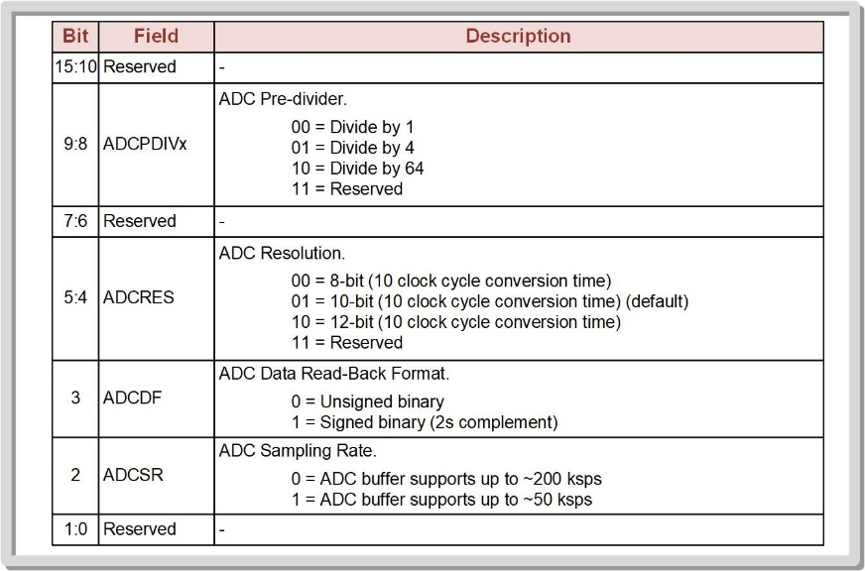
Ch. 15: Analog to Digital Converters
15.2 ADC Operation on the MSP430FR2355
ADCCTL2 contains:
settings for the first clock divider stage (ADCPDIVx)
the resolution of the ADC (ADCRES)
the data format of the result (ADCDF)
the range for the anticipated sample rate (ADCSR).
15.2 ADC Operation on the MSP430FR2355

Slide 66
Ch. 15: Analog to Digital Converters
15.2 ADC Operation on the MSP430FR2355
ADCCTL2 contains:
settings for the first clock divider stage (ADCPDIVx)
the resolution of the ADC (ADCRES)
the data format of the result (ADCDF)
the range for the anticipated sample rate (ADCSR).
Note that the default setting for ADCRES is 01 (10-bit).
If this setting is to be changed, the LSB of ADCRES needs to be cleared before the new settings are written.
15.2 ADC Operation on the MSP430FR2355

Slide 67
Ch. 15: Analog to Digital Converters
15.2 ADC Operation on the MSP430FR2355
ADCCTL2
We will use the following for the basic ADC setup
15.2 ADC Operation on the MSP430FR2355

Slide 68
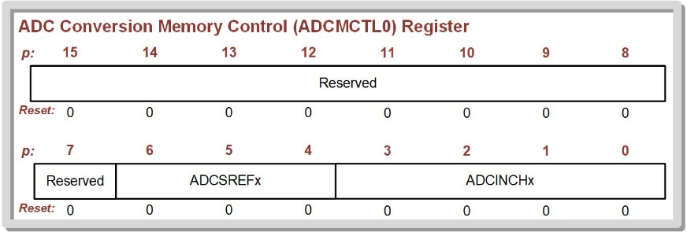
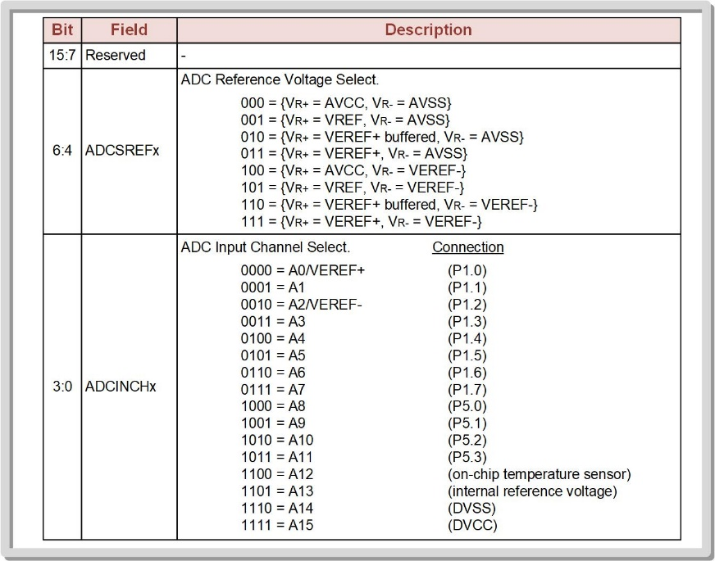
Ch. 15: Analog to Digital Converters
15.2 ADC Operation on the MSP430FR2355
ADCMCTL0 contains:
settings for the reference voltage selection (ADCSREFx).
“VREF” – refers to the internal reference voltages that the MCU can produce.
“VEREF+/-” – refers to the external pins.
“AVCC” – refers to the MCU power supply (+3.4v).
the ADC input channel that will be routed to the sample-and-hold stage (ADCINCHx).
15.2 ADC Operation on the MSP430FR2355

Slide 69
Ch. 15: Analog to Digital Converters
15.2 ADC Operation on the MSP430FR2355
ADCMCTL0 contains:
settings for the reference voltage selection (ADCSREFx).
“VREF” – refers to the internal reference voltages that the MCU can produce.
“VEREF+/-” – refers to the external pins.
“AVCC” – refers to the MCU power supply (+3.4v).
the ADC input channel that will be routed to the sample-and-hold stage (ADCINCHx).
Note: the Port Function Select settings of 0b11 selects the Analog function.
15.2 ADC Operation on the MSP430FR2355

Slide 70
Ch. 15: Analog to Digital Converters
15.2 ADC Operation on the MSP430FR2355
ADCMCTL0
We will use the following for the basic ADC setup
15.2 ADC Operation on the MSP430FR2355

Slide 71
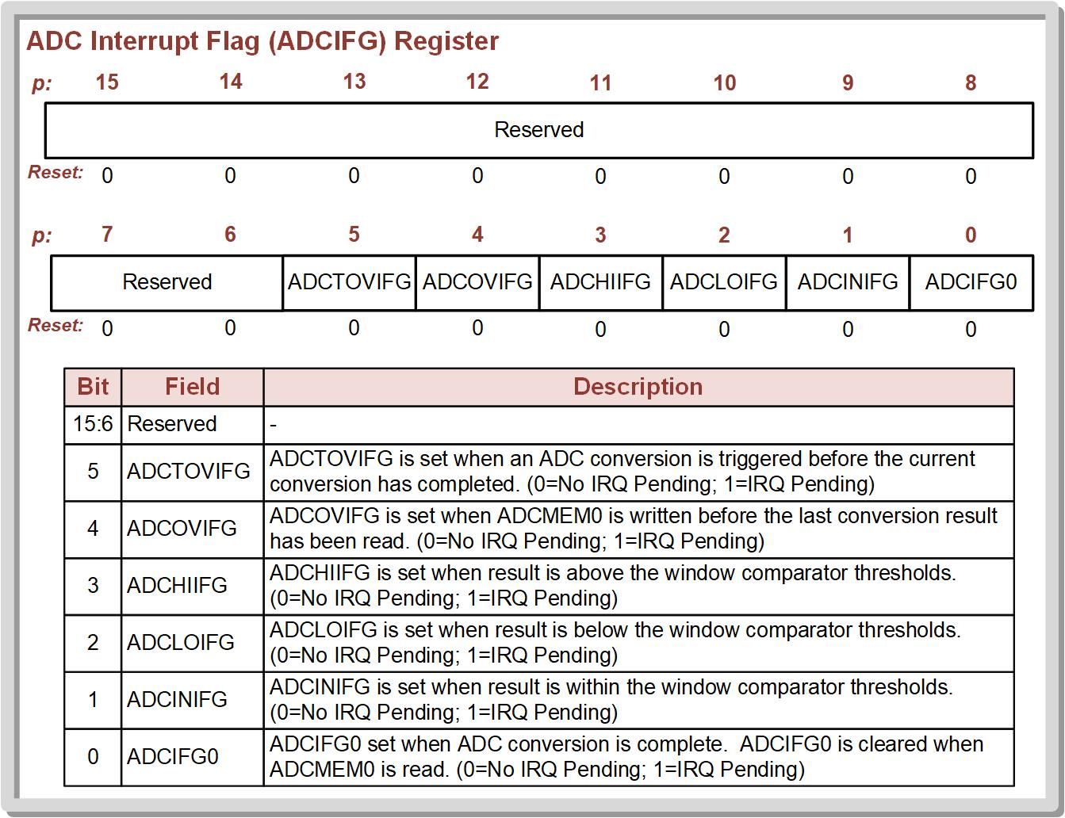
Ch. 15: Analog to Digital Converters
15.2 ADC Operation on the MSP430FR2355
The ADC peripheral contains six interrupt flags that can be used to monitor the status of the conversion.
15.2 ADC Operation on the MSP430FR2355

Slide 72
Ch. 15: Analog to Digital Converters
15.2 ADC Operation on the MSP430FR2355
There is an interrupt flag that will trigger when a conversion is complete (ADCIFG0).
15.2 ADC Operation on the MSP430FR2355

Slide 73
Ch. 15: Analog to Digital Converters
15.2 ADC Operation on the MSP430FR2355
There are three interrupts that can be used with a threshold window feature where the ADC watches for whether the input is within the window (ADCINIFG), below the window (ADCLOIFG), or above the window (ADCHIIFG).
15.2 ADC Operation on the MSP430FR2355

Slide 74
Ch. 15: Analog to Digital Converters
15.2 ADC Operation on the MSP430FR2355
There is also one interrupt to indicate if ADCMEM0 has been written to before the last conversion result has been read (ADCOVIFG).
15.2 ADC Operation on the MSP430FR2355

Slide 75
Ch. 15: Analog to Digital Converters
15.2 ADC Operation on the MSP430FR2355
Finally, there is one interrupt to indicate that a new conversion is triggered before the current conversion has completed (ADCTOVIFG).
15.2 ADC Operation on the MSP430FR2355

Slide 76
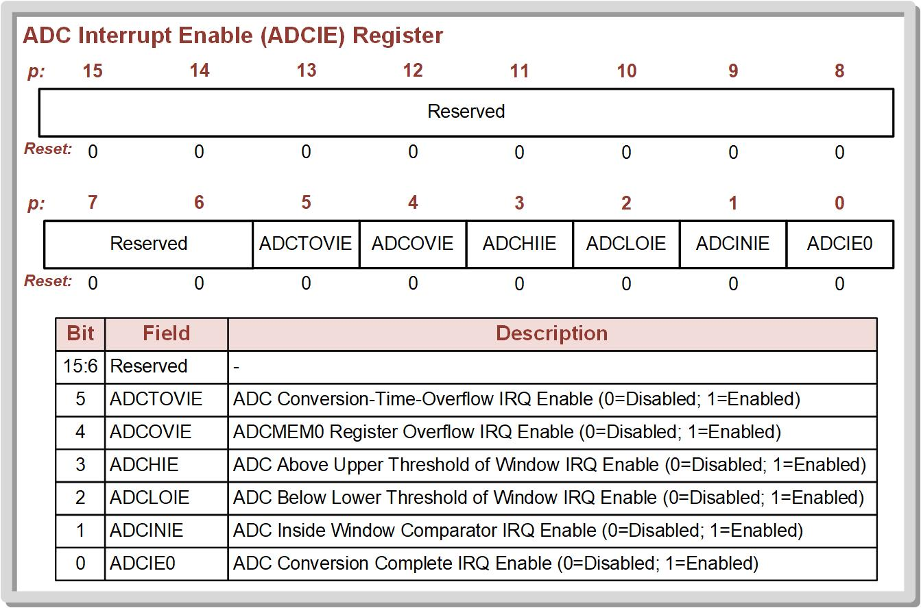
Ch. 15: Analog to Digital Converters
15.2 ADC Operation on the MSP430FR2355
15.2 ADC Operation on the MSP430FR2355

Slide 77
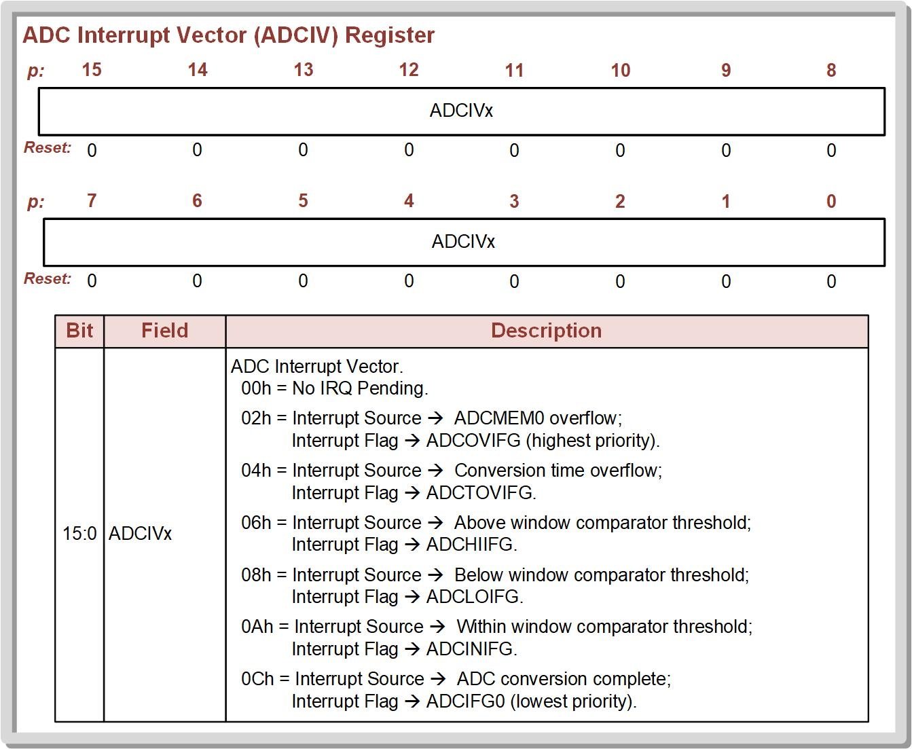
Ch. 15: Analog to Digital Converters
15.2 ADC Operation on the MSP430FR2355
15.2 ADC Operation on the MSP430FR2355

Slide 78
Embedded Systems Design
Chapter 15: Analog to Digital Converters
15.2 ADC Operation on the MSP430FR2355 - Configuration
www.youtube.com/c/DigitalLogicProgramming_LaMeres
Brock J. LaMeres, Ph.D.

Slide 79
Embedded Systems Design
Chapter 15: Analog to Digital Converters
15.2 ADC Operation on the MSP430FR2355 – Example: Reading an Analog Voltage using Polling Conversion-Complete IFG
Brock J. LaMeres, Ph.D.

Slide 80
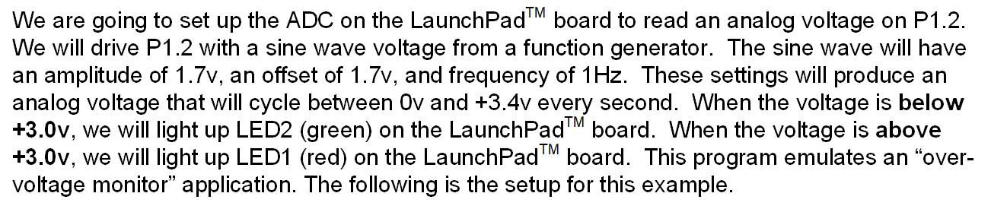
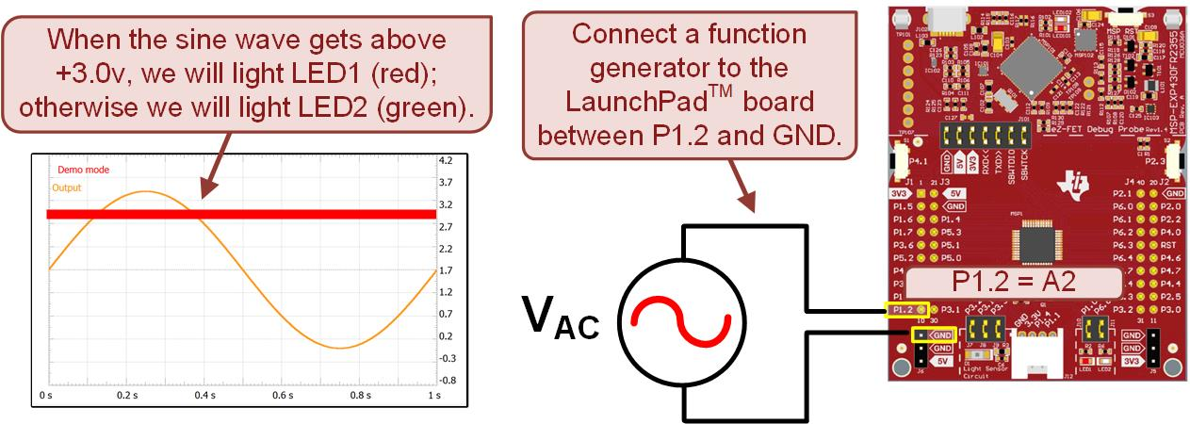
Ch. 15: Analog to Digital Converters
Reading an Analog Voltage With the ADC Using Polling to Monitor Conversion-Complete
15.2 ADC Operation on the MSP430FR2355

Slide 81
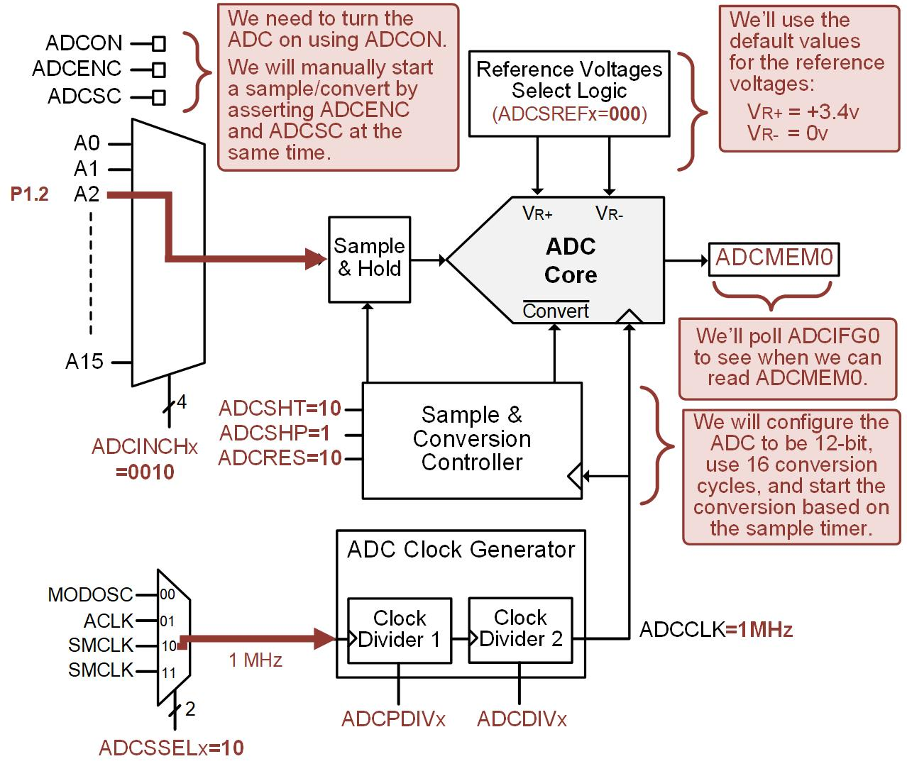
Ch. 15: Analog to Digital Converters
Reading an Analog Voltage With the ADC Using Polling to Monitor Conversion-Complete
Note: the Port Function Select settings of 0b11 selects the Analog function.
15.2 ADC Operation on the MSP430FR2355

Slide 82
Ch. 15: Analog to Digital Converters
Reading an Analog Voltage With the ADC Using Polling to Monitor Conversion-Complete
Step 1: In CCS, create a new C/C++ Empty Project (with main.c) titled:
C_ADC_Sampling_P1.2_Polling
Step 2: Type in the following code in main.c after the statement to stop the watchdog timer.
Image Courtesy of https://neodem.wp.horizon.ac.uk/
15.2 ADC Operation on the MSP430FR2355

Slide 83
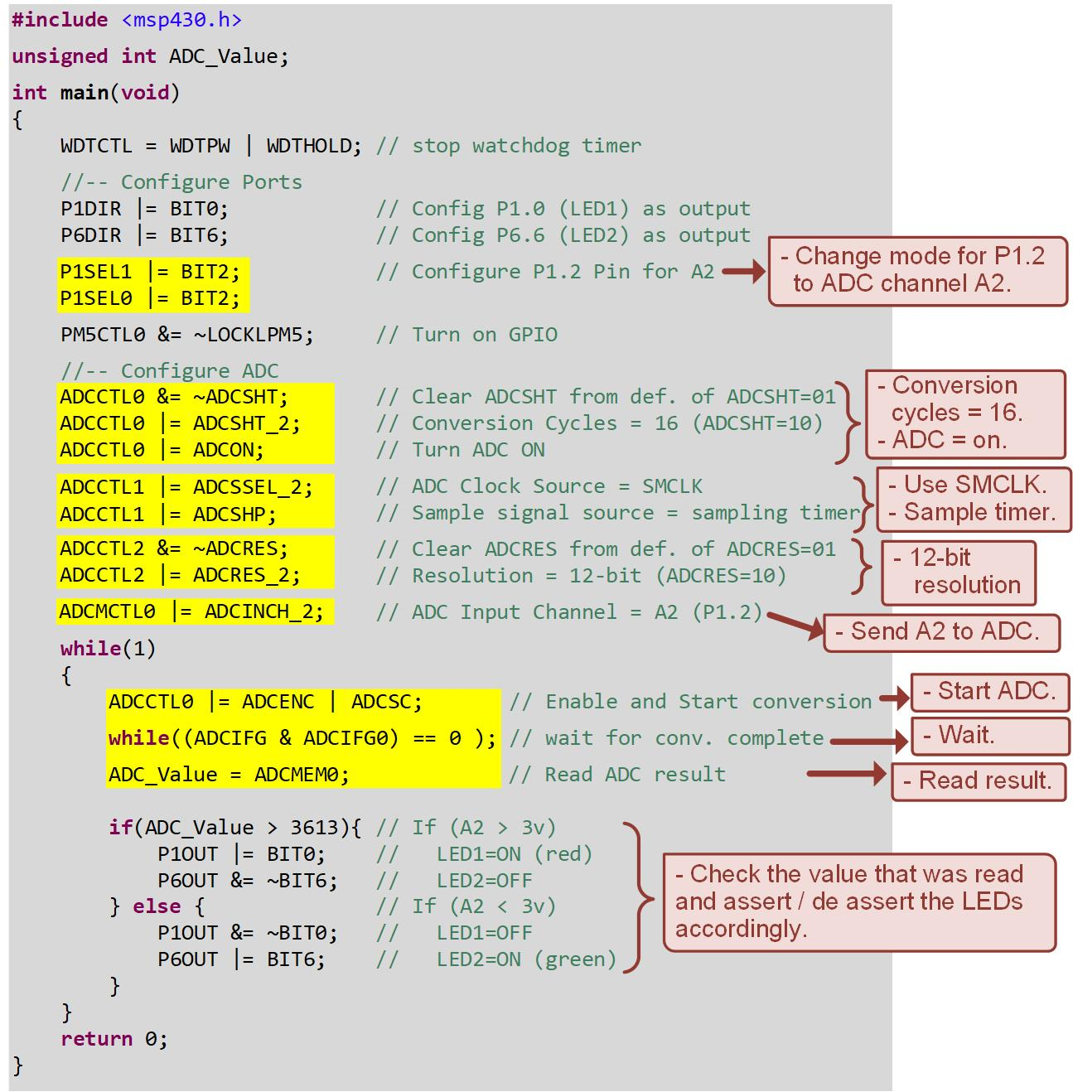
Ch. 15: Analog to Digital Converters
Reading an Analog Voltage With the ADC Using Polling to Monitor Conversion-Complete
15.2 ADC Operation on the MSP430FR2355

Slide 84

Ch. 15: Analog to Digital Converters
Reading an Analog Voltage With the ADC Using Polling to Monitor Conversion-Complete
Step 3: Save, debug, and run your program. Also run your function generator to produce the sine wave on P1.2.
Image Courtesy of
Recording Connection of Canada
Image Courtesy of
Recording Connection of Canada
Image Courtesy of
Recording Connection of Canada
Image Courtesy of https://neodem.wp.horizon.ac.uk/
Image Courtesy of
Recording Connection of Canada
Image Courtesy of
Recording Connection of Canada
Image Courtesy of
Recording Connection of Canada
Image Courtesy of
Recording Connection of Canada
Image Courtesy of
Recording Connection of Canada
15.2 ADC Operation on the MSP430FR2355

Slide 85
Embedded Systems Design
Chapter 15: Analog to Digital Converters
15.2 ADC Operation on the MSP430FR2355 – Example: Reading an Analog Voltage using Polling Conversion-Complete IFG
www.youtube.com/c/DigitalLogicProgramming_LaMeres
Brock J. LaMeres, Ph.D.

Slide 86
Embedded Systems Design
Chapter 15: Analog to Digital Converters
15.2 ADC Operation on the MSP430FR2355 – Example: Reading an Analog Voltage using Polling Conversion-Complete IRQ
Brock J. LaMeres, Ph.D.

Slide 87
Ch. 15: Analog to Digital Converters
Reading an Analog Voltage With the ADC Using an IRQ to Monitor Conversion-Complete
15.2 ADC Operation on the MSP430FR2355

Slide 88
Ch. 15: Analog to Digital Converters
Reading an Analog Voltage With the ADC Using an IRQ to Monitor Conversion-Complete
15.2 ADC Operation on the MSP430FR2355

Slide 89
Ch. 15: Analog to Digital Converters
Reading an Analog Voltage With the ADC Using an IRQ to Monitor Conversion-Complete
We’ll first setup the Port Function Select registers to use the Analog input on P1.2.
P1SEL1(2):P1SEL(0)=11
15.2 ADC Operation on the MSP430FR2355

Slide 90
Ch. 15: Analog to Digital Converters
Reading an Analog Voltage With the ADC Using an IRQ to Monitor Conversion-Complete
ADCCTL0
ADCSHT = 10; Conversion cycles = 16
ADCON = 1; Turn ADC On
15.2 ADC Operation on the MSP430FR2355

Slide 91
Ch. 15: Analog to Digital Converters
Reading an Analog Voltage With the ADC Using an IRQ to Monitor Conversion-Complete
ADCCTL1
ADCSSEL = 10; SMCLK
ADCSHP = 1; Use ADC for trigger
15.2 ADC Operation on the MSP430FR2355

Slide 92
Ch. 15: Analog to Digital Converters
Reading an Analog Voltage With the ADC Using an IRQ to Monitor Conversion-Complete
ADCCTL2
ADCRES = 10; 12-Bit
15.2 ADC Operation on the MSP430FR2355

Slide 93
Ch. 15: Analog to Digital Converters
Reading an Analog Voltage With the ADC Using an IRQ to Monitor Conversion-Complete
ADCMCTL0
ADCINCH = 0010; Use A2
15.2 ADC Operation on the MSP430FR2355

Slide 94
Ch. 15: Analog to Digital Converters
Reading an Analog Voltage With the ADC Using an IRQ to Monitor Conversion-Complete
Notable Default Settings
V_{R+} = VCC, V_{R-} = GND
Prescalars = 1
Format = Unsigned
Single Conversion / Channel
15.2 ADC Operation on the MSP430FR2355

Slide 95
Ch. 15: Analog to Digital Converters
Reading an Analog Voltage With the ADC Using an IRQ to Monitor Conversion-Complete
Our Design
Start conversion by: ADCENC = 1, ADCSC= 1.
Use ADCIFG0 to trigger IRQ when complete.
Vector = ADC_VECTOR.
15.2 ADC Operation on the MSP430FR2355

Slide 96
Ch. 15: Analog to Digital Converters
Reading an Analog Voltage With the ADC Using an IRQ to Monitor Conversion-Complete
Step 1: In CCS, create a new C/C++ Empty Project (with main.c) titled:
C_ADC_Sampling_P1.2_IRQ
Step 2: Type in the following code in main.c after the statement to stop the watchdog timer.
Image Courtesy of https://neodem.wp.horizon.ac.uk/
15.2 ADC Operation on the MSP430FR2355

Slide 97
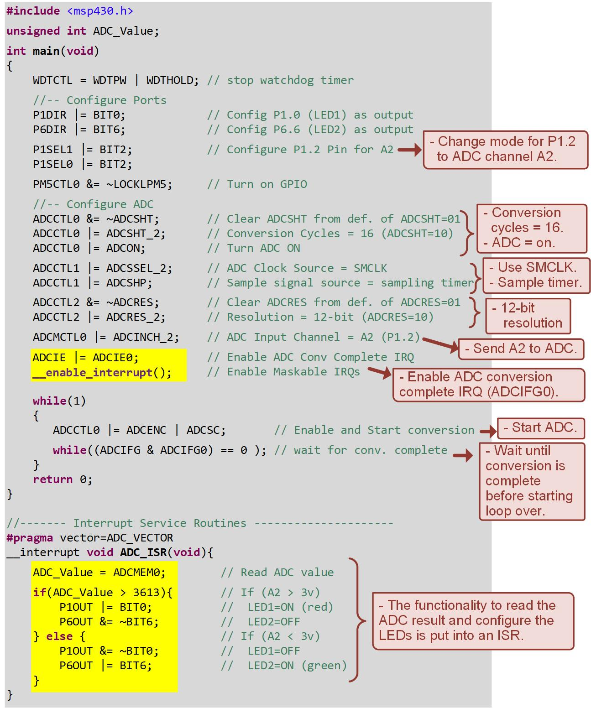

Ch. 15: Analog to Digital Converters
Reading an Analog Voltage With the ADC Using an IRQ to Monitor Conversion-Complete
Step 3: Save, debug, and run your program. Also run your function generator to produce the sine wave on P1.2.
15.2 ADC Operation on the MSP430FR2355

Slide 98
Embedded Systems Design
Chapter 15: Analog to Digital Converters
15.2 ADC Operation on the MSP430FR2355 – Example: Reading an Analog Voltage using Polling Conversion-Complete IRQ
www.youtube.com/c/DigitalLogicProgramming_LaMeres
Brock J. LaMeres, Ph.D.

Slide 99
Embedded Systems Design
Chapter 15: Analog to Digital Converters
15.2 ADC Operation on the MSP430FR2355 – Example: Reading Analog Voltage w Conversion-Complete IRQ & LPM
Brock J. LaMeres, Ph.D.

Slide 100
Ch. 15: Analog to Digital Converters
Reading Analog Voltage w Conversion-Complete IRQ & LPM
15.2 ADC Operation on the MSP430FR2355

Slide 101
Ch. 15: Analog to Digital Converters
Reading Analog Voltage w Conversion-Complete IRQ & LPM
15.2 ADC Operation on the MSP430FR2355

Slide 102
Ch. 15: Analog to Digital Converters
Reading Analog Voltage w Conversion-Complete IRQ & LPM
We’ll first setup the Port Function Select registers to use the Analog input on P1.2.
P1SEL1(2):P1SEL(0)=11
15.2 ADC Operation on the MSP430FR2355

Slide 103
Ch. 15: Analog to Digital Converters
Reading Analog Voltage w Conversion-Complete IRQ & LPM
ADCCTL0
ADCSHT = 10; Conversion cycles = 16
ADCON = 1; Turn ADC On
15.2 ADC Operation on the MSP430FR2355

Slide 104
Ch. 15: Analog to Digital Converters
Reading Analog Voltage w Conversion-Complete IRQ & LPM
ADCCTL1
ADCSSEL = 10; SMCLK
ADCSHP = 1; Use ADC for trigger
15.2 ADC Operation on the MSP430FR2355

Slide 105
Ch. 15: Analog to Digital Converters
Reading Analog Voltage w Conversion-Complete IRQ & LPM
ADCCTL2
ADCRES = 10; 12-Bit
15.2 ADC Operation on the MSP430FR2355

Slide 106
Ch. 15: Analog to Digital Converters
Reading Analog Voltage w Conversion-Complete IRQ & LPM
ADCMCTL0
ADCINCH = 0010; Use A2
15.2 ADC Operation on the MSP430FR2355

Slide 107
Ch. 15: Analog to Digital Converters
Reading Analog Voltage w Conversion-Complete IRQ & LPM
Notable Default Settings
V_{R+} = VCC, V_{R-} = GND
Prescalars = 1
Format = Unsigned
Single Conversion / Channel
15.2 ADC Operation on the MSP430FR2355

Slide 108
Ch. 15: Analog to Digital Converters
Reading Analog Voltage w Conversion-Complete IRQ & LPM
Our Design
Start conversion by: ADCENC = 1, ADCSC= 1.
Go into LPM0 (MCLK dis, SMCLK en)
Use ADCIFG0 to trigger IRQ when complete.
Vector = ADC_VECTOR.
15.2 ADC Operation on the MSP430FR2355

Slide 109
Ch. 15: Analog to Digital Converters
Reading an Analog Voltage With the ADC Using an IRQ and Low Power Mode
Step 1: In CCS, create a new C/C++ Empty Project (with main.c) titled:
C_ADC_Sampling_P1.2_LPM
Step 2: Type in the following code in main.c after the statement to stop the watchdog timer.
Image Courtesy of https://neodem.wp.horizon.ac.uk/
15.2 ADC Operation on the MSP430FR2355

Slide 110
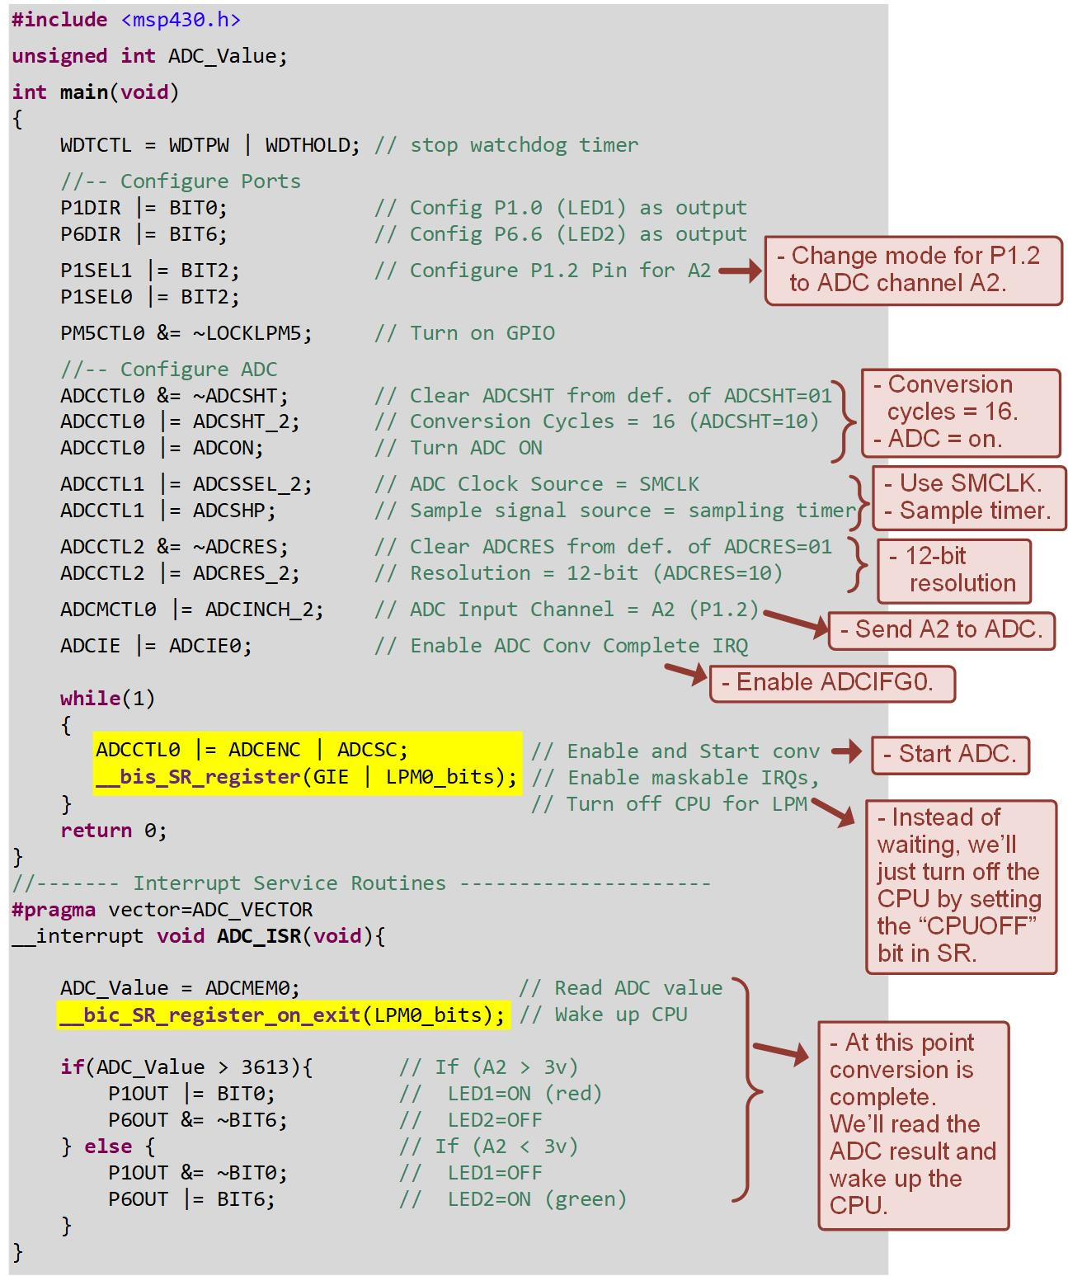

Ch. 15: Analog to Digital Converters
Reading an Analog Voltage With the ADC Using an IRQ to Monitor Conversion-Complete
Step 3: Save, debug, and run your program. Also run your function generator to produce the sine wave on P1.2.
15.2 ADC Operation on the MSP430FR2355

Slide 111
Embedded Systems Design
Chapter 15: Analog to Digital Converters
15.2 ADC Operation on the MSP430FR2355 – Example: Reading Analog Voltage w Conversion-Complete IRQ & LPM
www.youtube.com/c/DigitalLogicProgramming_LaMeres
Brock J. LaMeres, Ph.D.

